Slide 1
Marine Industry CSI Award Badging Program
Badge Usage Guidelines

Slide 2
01
Introduction
Marine Industry CSI Award Badging Program

Slide 3
Overview
The Marine Industry CSI Award Badging Program is designed to create enhanced awareness and visibility for the Marine Industry CSI Award winners among consumers. Award winners will have the opportunity to participate in this program by displaying NMMA-Awarded manufacturer and/or dealer customer satisfaction badges on many websites used by consumers during the boat shopping process. The badge proudly displays that a brand and/or its dealers have achieved a mark of excellence in customer satisfaction, instilling more trust and confidence in the buying process.
This guide illustrates the usage guidelines when displaying customer satisfaction badges on OEM brand and dealer websites and/or other marketing materials.
Marine Industry CSI Award Badging Program

Slide 4
02
Badges
Marine Industry CSI Award Badging Program

Slide 5
Branding
OEM-Level Badge
Dealer-Level Badge
Badge presented to Marine Industry CSI Award winning manufacturers for superior customer satisfaction.
Badge presented to Marine Industry CSI Award winning dealers for specific NMMA participating brands.
Marine Industry CSI Award Badging Program

Slide 6
03
Usage
Marine Industry CSI Award Badging Program

Slide 7
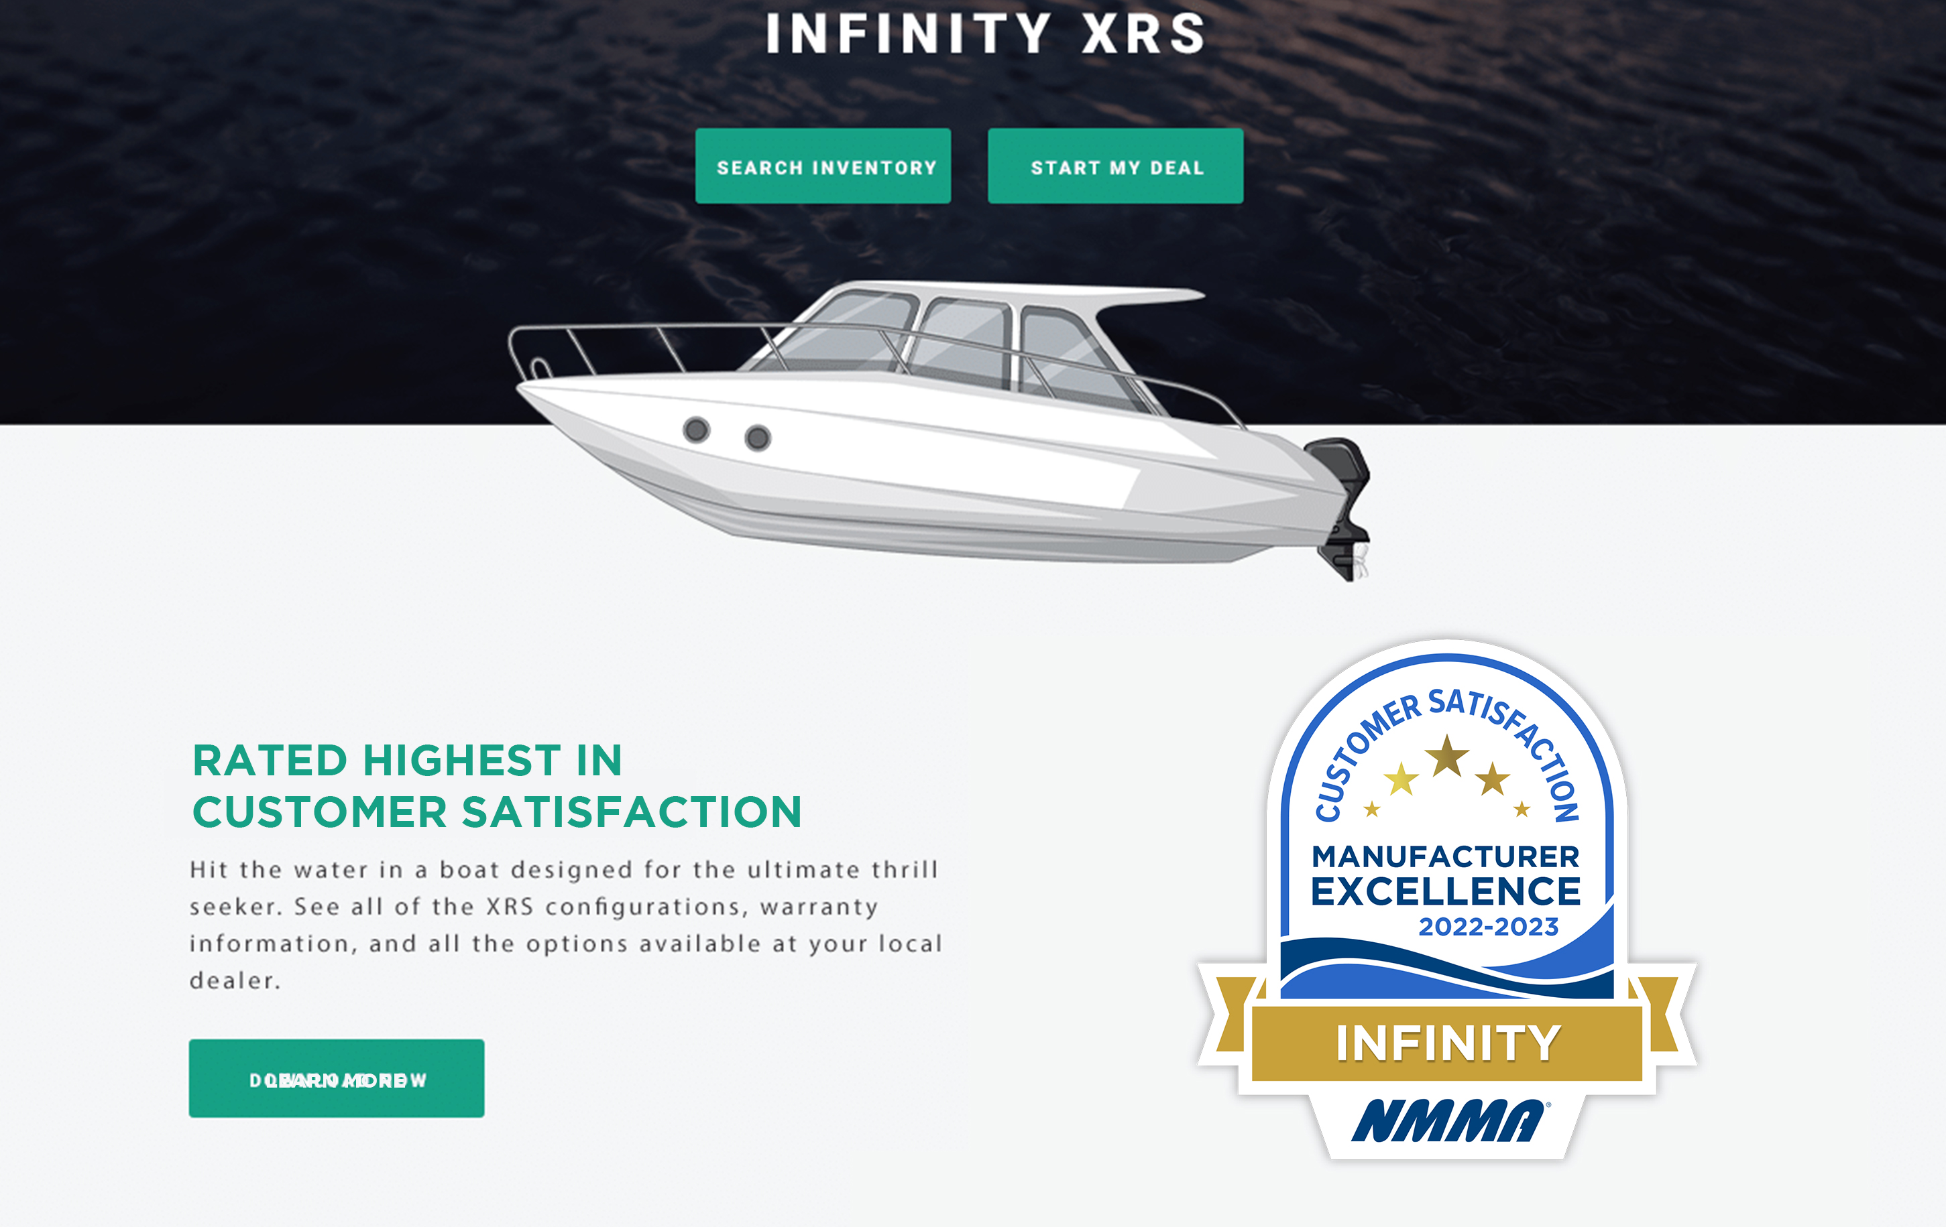
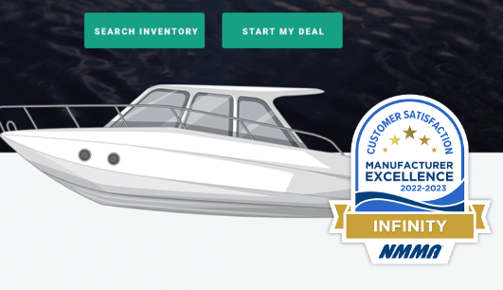
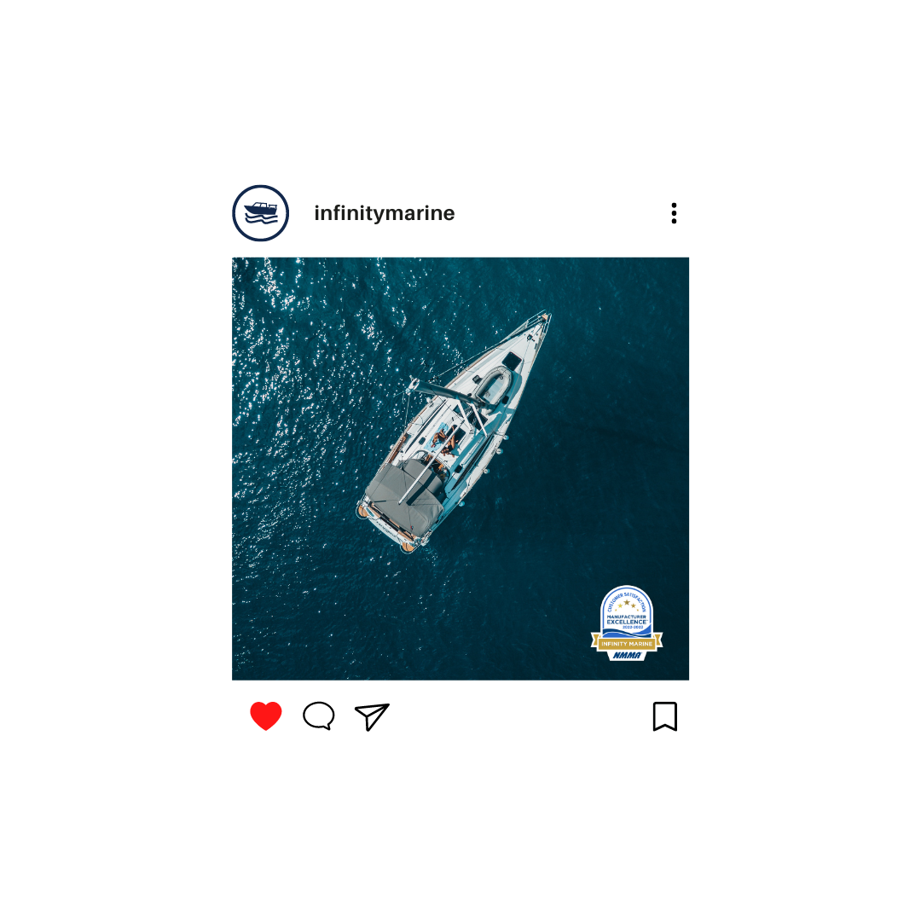
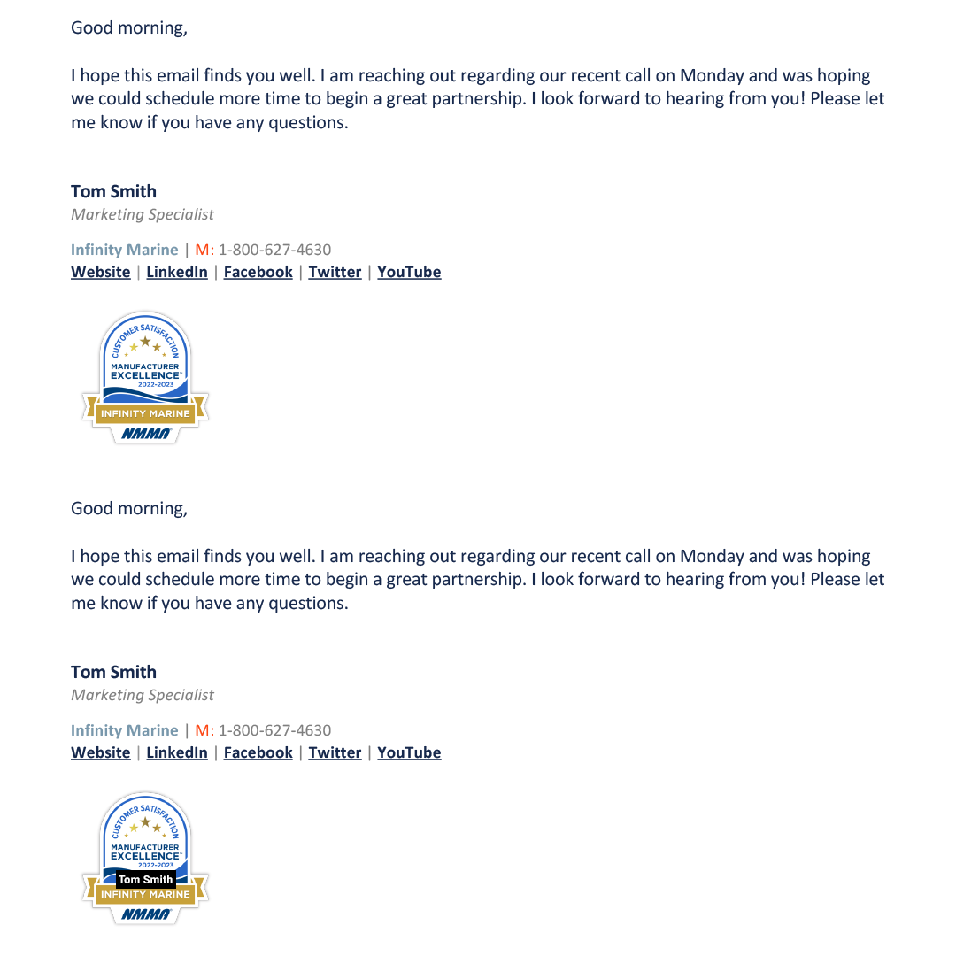
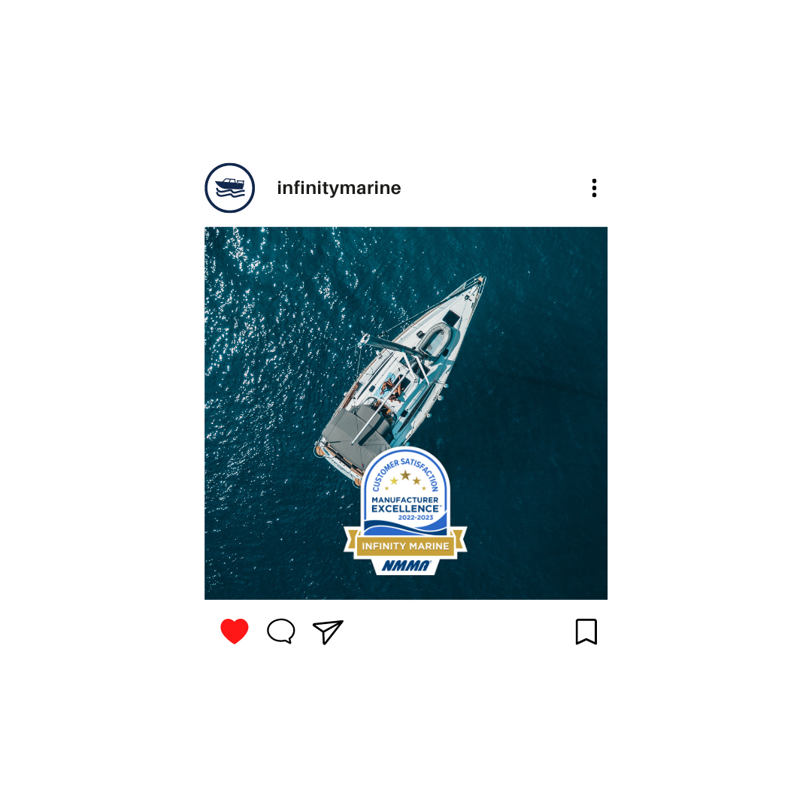
OEM Usage
Contact with Design Elements
Modified Badge
Correct Usage
You CAN display the badge on your website and marketing communications (emails, social media, digital or print advertisements, events, etc.).
Do NOT reproduce, replicate, or modify the design (this includes no alteration of shape, coloring, text, years, etc.).
Ensure images, text, and other design elements don’t come in direct contact with the badge.
Correct Usage
Correct Usage
Contact with Design Elements
Marine Industry CSI Award Badging Program
Modified Badge

Slide 8
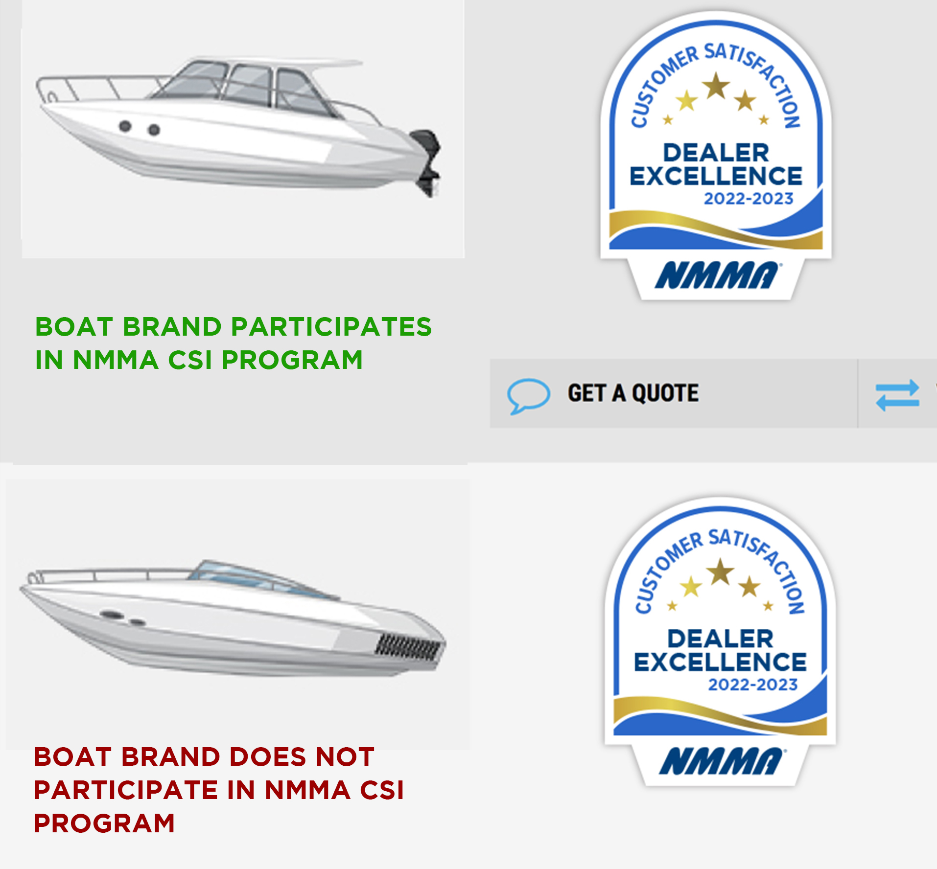
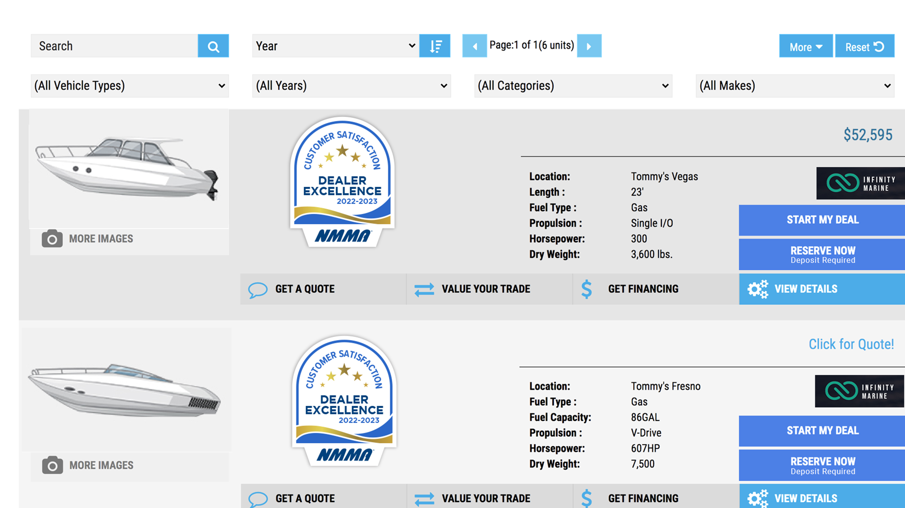
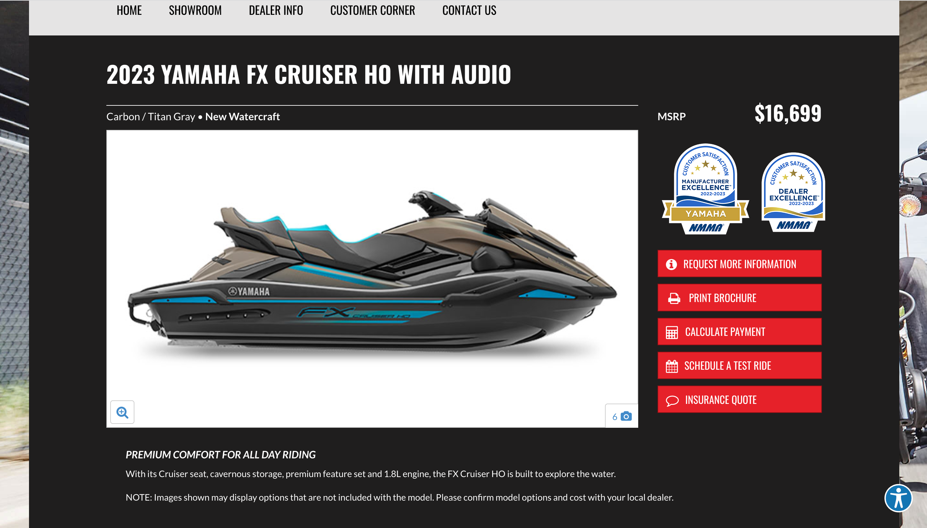
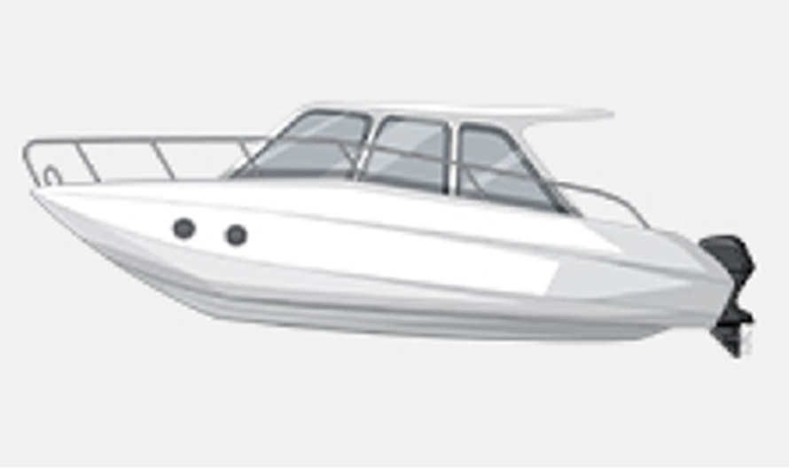
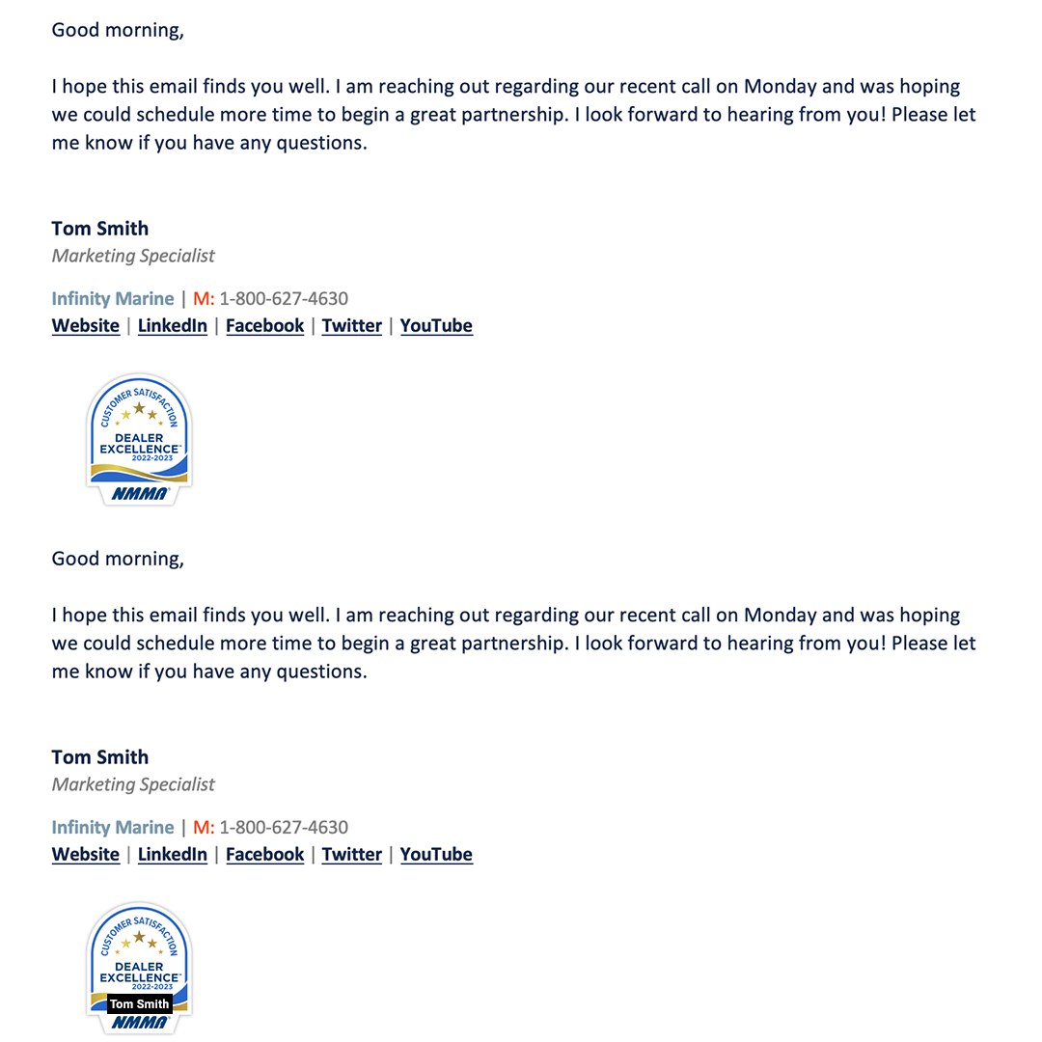
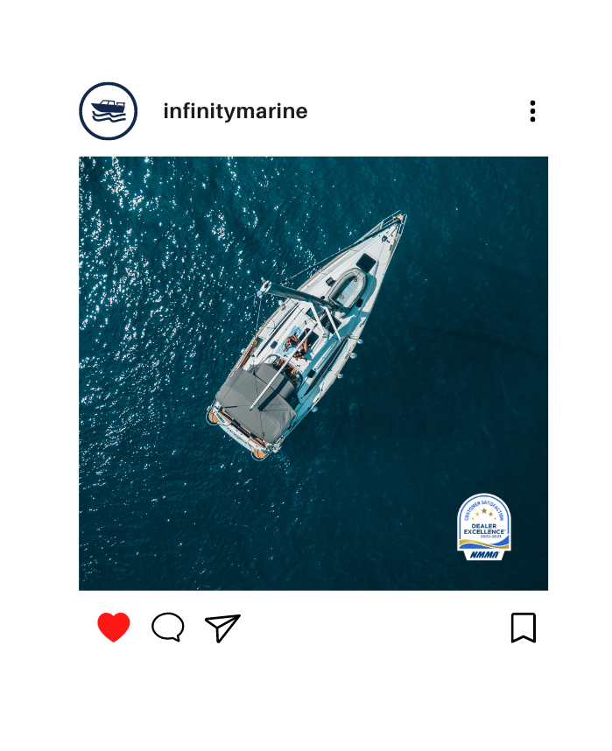
Dealer Usage
You CAN display the badge on your website and marketing communications (emails, social media, digital or print advertisements, events, etc.).
Do NOT reproduce, replicate, or modify the design (this includes no alteration of shape, coloring, text, years, etc.).
Ensure images, text, and other design elements don’t come in direct contact with the badge.
Badge can only be used where a specific OEM brand appears (IF that OEM brand participates in the NMMA CSI program). Placement on inventory units can only occur if that OEM brand participates in the NMMA CSI program.
Badge CAN also be used on pages where there are no specific OEM brand call-outs, such as the home page or About Us page.
Badge placement on brand that does NOT participate in program
Modified Badge
Correct Usage
Correct Usage
Correct Usage
Contact with Design Elements
Marine Industry CSI Award Badging Program
Modified Badge

Slide 9
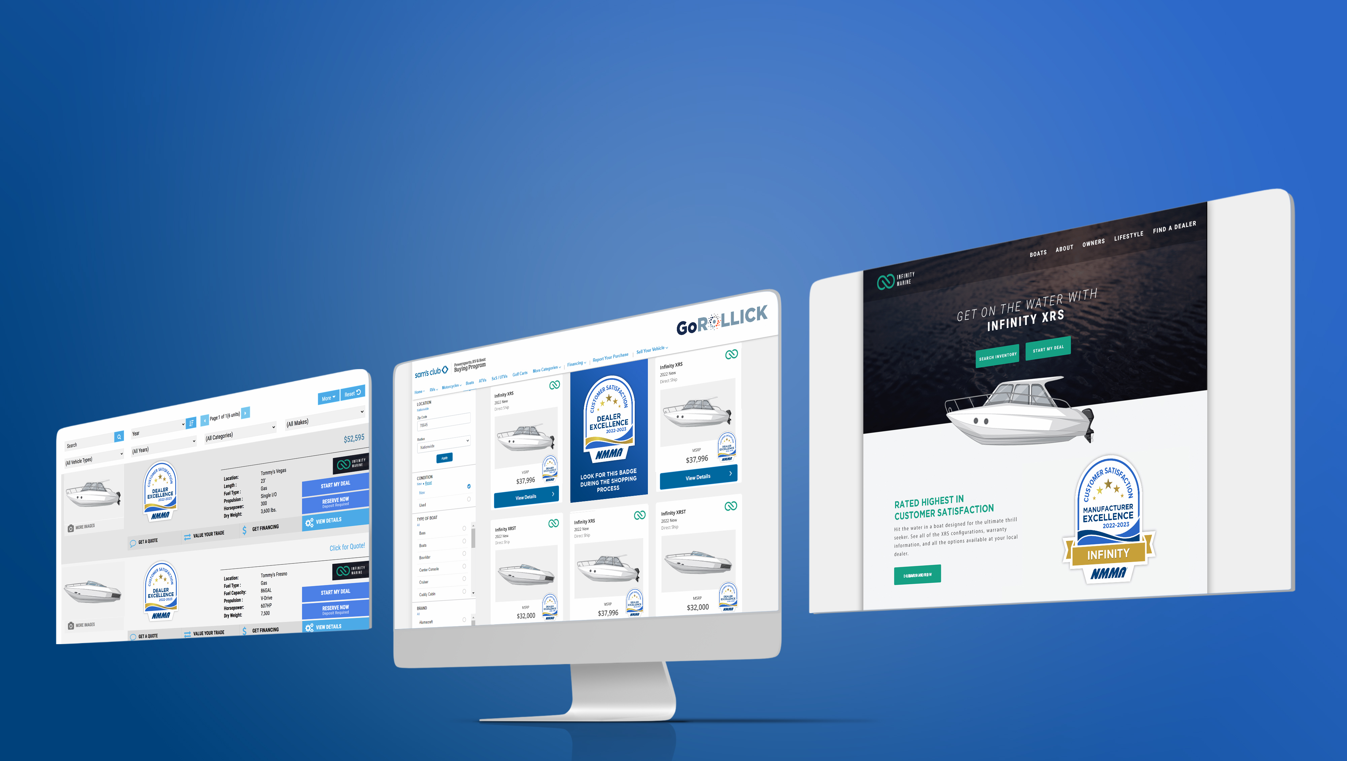
Questions?
Contact Rollick at CSIsupport@Rollick.io

